Slide 1
e-Clinic
To empower health facilities in remote areas.

Slide 2
INTRODUCTION
We all know that medical treatment is basic need for all people. We have made a medical expert system under the Digital India, which is very helpful for people belonging to remote areas specially in villages, forest, hills, etc. who are not much privileged to get best possible medical prescription and suggestions.

Slide 3
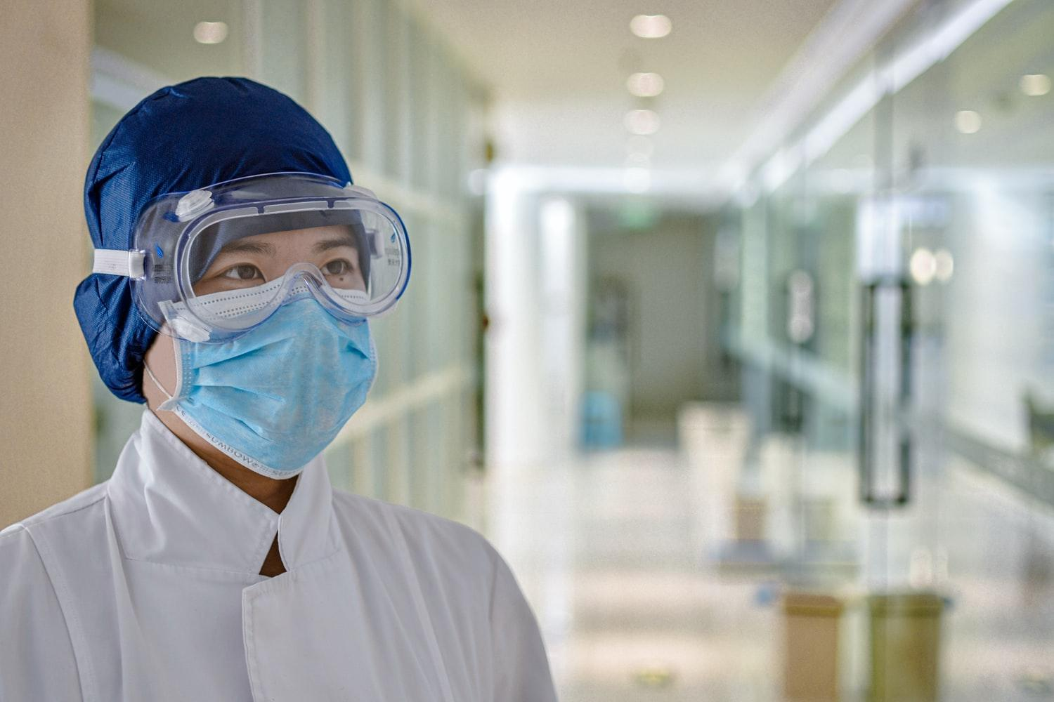
India facing shortage of 600,000 doctors , 2 million nurses : Study
As per the most recent census data from 2011, India had just about 0.7 hospital beds for every 1,000 Indians.
Source : The Economic Times

Slide 4
Solution : E-Clinic
This platform will basically help people to have an online availability of doctors virtually.
A person with basic knowledge of internet can easily access it .

Slide 5
Solution : E-Clinic
It can help filling the void of doctors in remote areas .
No pre-booking of appointments with doctors is required, service can be provided at any moment of need.
3.
4.

Slide 6
FUTURE PERSPECTIVES:-
It can be converted in fully voice controlled program in regional languages.

